Slide 1
Network and Communication
Module 1 Networking Principles and layered architecture
Dr. S.L.Jayalakshmi,
VIT Chennai

Slide 2
Text book
Textbook
Larry Peterson, Bruce S. Davie. Computer Networks: a system approach. 5th Edition.
Data Communications and Networking, Behrouz A. Forouzan, McGraw Hill Education, 5th Ed., 2012

Slide 3
Outline(Outline(module1_part 2)
Protocols
Popular Protocols
Standards
List of Standard Organizations
OSI Model
TCP/IP Protocol

Slide 4
PROTOCOLS & STANDARDS

Slide 5
Protocols
Network Protocols
Set of rules that governs/used for communication. The key elements are given below.
1. Syntax: structure/format of the data. Meaning the order in which the data is present.
2. Semantics: The meaning of each section of bits.
3. Timing: Refers to two characteristics: - When data should be sent and how fast they can be sent.

Slide 6
How it works?
Network protocols take large-scale processes and break them down into small, specific tasks or functions.
Each layer is assigned a function.
This occurs at every level of the network and each function must cooperate at each level to complete the larger task at hand.

Slide 7
List of Network protocols
Communication
Network management
Security

Slide 8
Communication Protocol
Communication Protocol is a system of rules that allow two or more entities of a communications system to transmit information via any kind of variation of a physical quantity.

Slide 9
Simple Network Management Protocol: SNMP
An Internet Standard protocol for
collecting and organizing information about managed devices on IP networks
modifying that information to change device behavior.
Devices that typically support SNMP include cable modems, routers, switches, servers, workstations, printers, and more.

Slide 10
Network security protocols
Ensures the security and integrity of data in transit over a network connection.
Network security protocols define the processes and methodology to secure network data from any illegitimate attempt to review or extract the contents of data.

Slide 11
Popular Protocols
ISDN - Integrated Services Digital Network. Communication protocol offered by phone companies which allows phone networks to carry voice, video, and data.
CDMA - Code Division Multiple Access. X.25 - ITU’s standard that defines how connections between terminal equipment and computers are maintained.
TCP/IP (Transmission Control Protocol/Internet Protocol) suite
ARP (Address Resolution Protocol)
DNS (Domain Name System)
FTP (File Transfer Protocol)
HTTP (Hyper Text Transfer Protocol)
HTTPS (Hypertext Transfer Protocol Secure)
ICMP (Internet Control Message Protocol)
IGMP (Internet Group Management Protocol)
IMAP4 (Internet Message Access Protocol version 4)

Slide 12
Standards
Standard provides a model for development that makes it possible for a product to work regardless of the individual manufacturer
Dejure – haven’t approved by organized body, but adopted as standards through wide spread use ASCII USB
Defacto - Proprietary and Non proprietary
Proprietary – invented by commercial organizations; close off communications
Non proprietary-developed by groups or committees; open standards QWERTY

Slide 13
List of Standard Organizations
International Standard Organization (ISO). Responsible for a wide range of standards including networking standards.
CCITT - Consultative Committee for International Telegraph and Telephone. Responsible for development of Communication standards.
International Telecommunications Union-Telecommunications Standards Sector (ITU-T) - develops worldwide standards for telecommunication technologies.
American National Standard Institute (ANSI)
Institute of International Electrical and Electronics Engineers (IEEE)
Electronic Industries Association (EIA) .
Telecommunications Industry Association (TIA) and other leading telecommunication companies worked cooperatively to create ANSI/TIA/EIA-568-A standard for commercial buildings.

Slide 14
OSI MODEL

Slide 15
The OSI model
ISO is the organization. OSI is the model.
International Standards Organization (ISO) is a multinational body dedicated to worldwide agreement on international standards - Established in 1947.
An ISO standard that covers all aspects of network communications is the Open Systems Interconnection (OSI) model - introduced in the late 1970s.
The Open Systems Interconnection (OSI) model is a conceptual model created by the ISO which enables diverse communication systems to communicate using standard protocols.
Notes:
OSI (Open Systems Interconnection) is a reference model for how applications communicate over a network.
A reference model is a conceptual framework for understanding relationships. The purpose of the OSI reference model is to guide vendors and developers so the digital communication products and software programs they create can interoperate, and to facilitate a clear framework that describes the functions of a networking or telecommunication system.

Slide 16
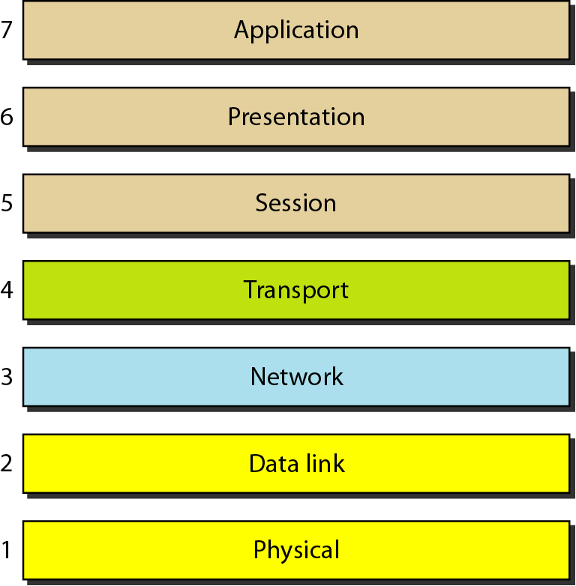
Seven layers of the OSI model
Source: Data Communications and Networking – Behrouz A. Forouzan

Slide 17
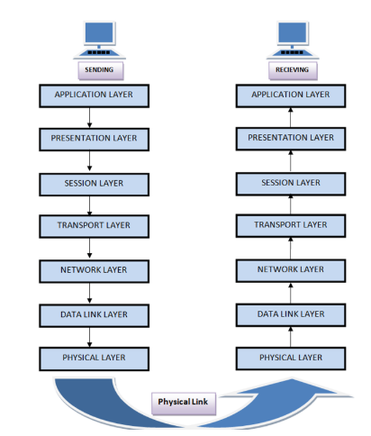

Slide 18
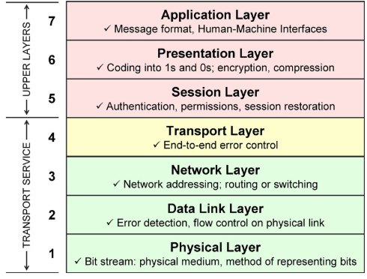

Slide 19
Functions of each layers
Layer 1—The physical layer:
This layer transmits bits from one computer to another and regulates the transmission of a stream of bits over a physical medium. This layer defines how the cable is attached to the network adapter and what transmission technique is used to send data over the cable.
Layer 2—The data-link layer:
This layer packages raw bits from the Physical layer into frames (logical, structures packets for data). It is responsible for transferring frames from one computer to another, without errors. After sending a frame, it waits for an acknowledgment from the receiving computer.
Layer 3—The network layer:
This layer handles the routing of the data, addresses messages and translates logical addresses and names into physical addresses. It also determines the route from the source to the destination computer and manages traffic problems (flow control), such as switching, routing, and controlling the congestion of data packets.
Layer 4—The transport layer:
This layer handles error recognition and recovery, manages the end-to-end control (for example, determining whether all packets have arrived) and error-checking. It ensures complete data transfer.

Slide 20
Functions of each layers
Layer 5—The session layer:
This layer allows applications on different computers to establish, use, and end a session/connection. This layer establishes dialog control between the two computers in a session, regulating which side transmits, and when and how long it transmits.
Layer 6—The presentation layer:
This is a layer, usually part of an operating system, that converts incoming and outgoing data from one presentation format to another (for example, from a text stream into a popup window with the newly arrived text). This layer also manages security issues by providing services such as data encryption and compression. It’s sometimes called the syntax layer.
Layer 7— The application layer:
This is the layer at which communication partners are identified, quality of service is identified, user authentication and privacy are considered, and any constraints on data syntax are identified. (This layer is not the application itself, although some applications may perform application layer functions). It represents the services that directly support applications such as software for file transfers, database access, email, and network games.

Slide 21
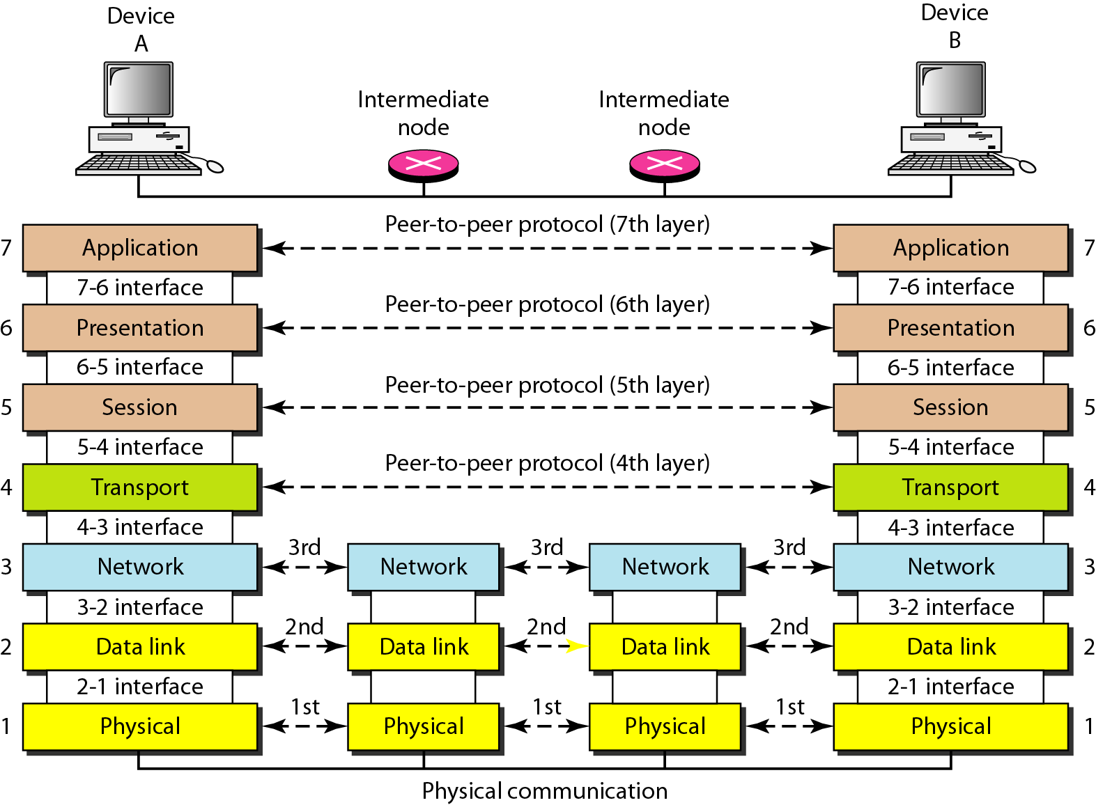
The interaction between layers in the OSI model
Source: Data Communications and Networking – Behrouz A. Forouzan

Slide 22
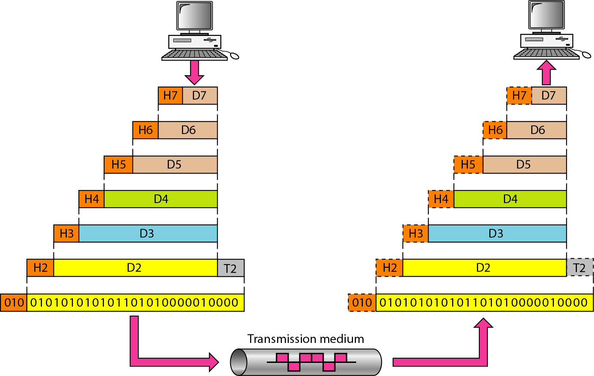
An exchange using the OSI model
Source: Data Communications and Networking – Behrouz A. Forouzan

Slide 23
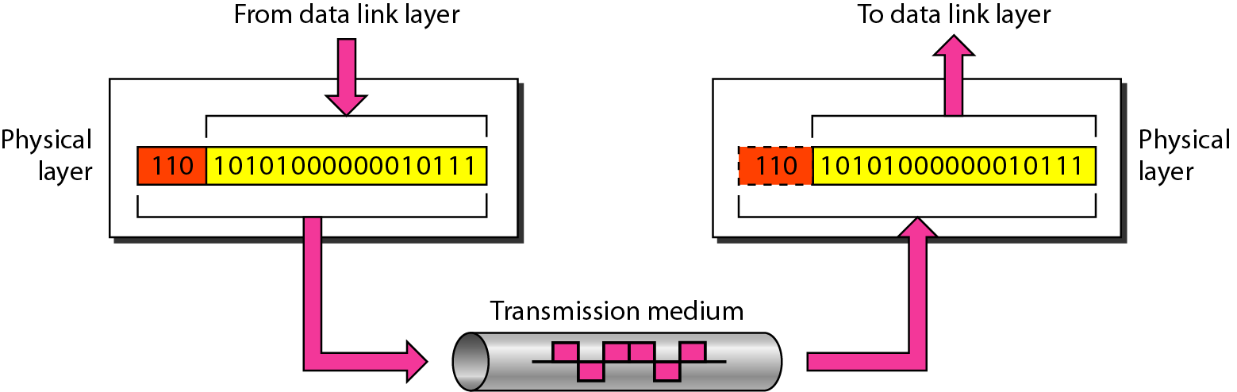
Physical layer
The physical layer is responsible for movements of
individual bits from one hop (node) to the next
Source: Data Communications and Networking – Behrouz A. Forouzan

Slide 24
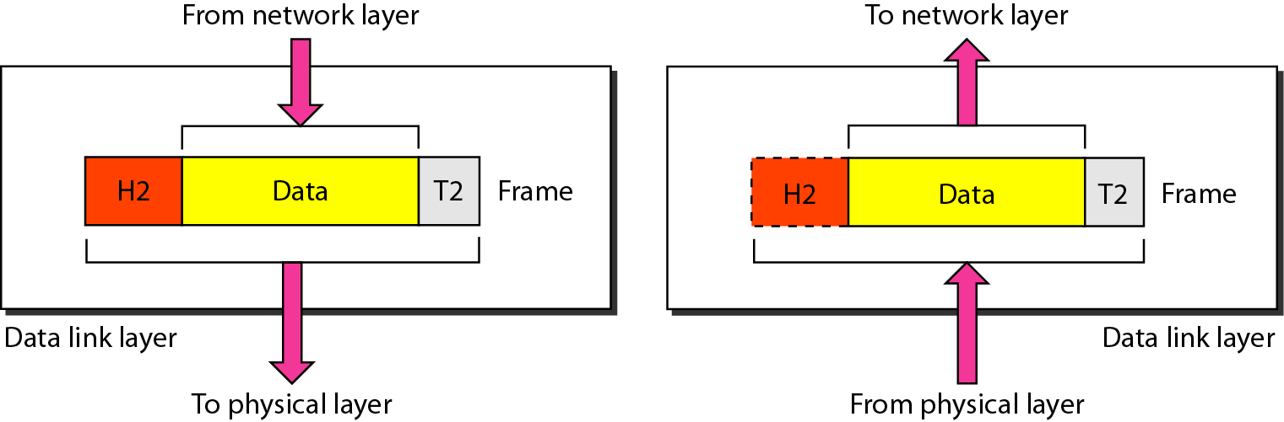
Data link layer (Cont....)
The data link layer is responsible for moving frames from one hop (node) to the next.
Source: Data Communications and Networking – Behrouz A. Forouzan

Slide 25
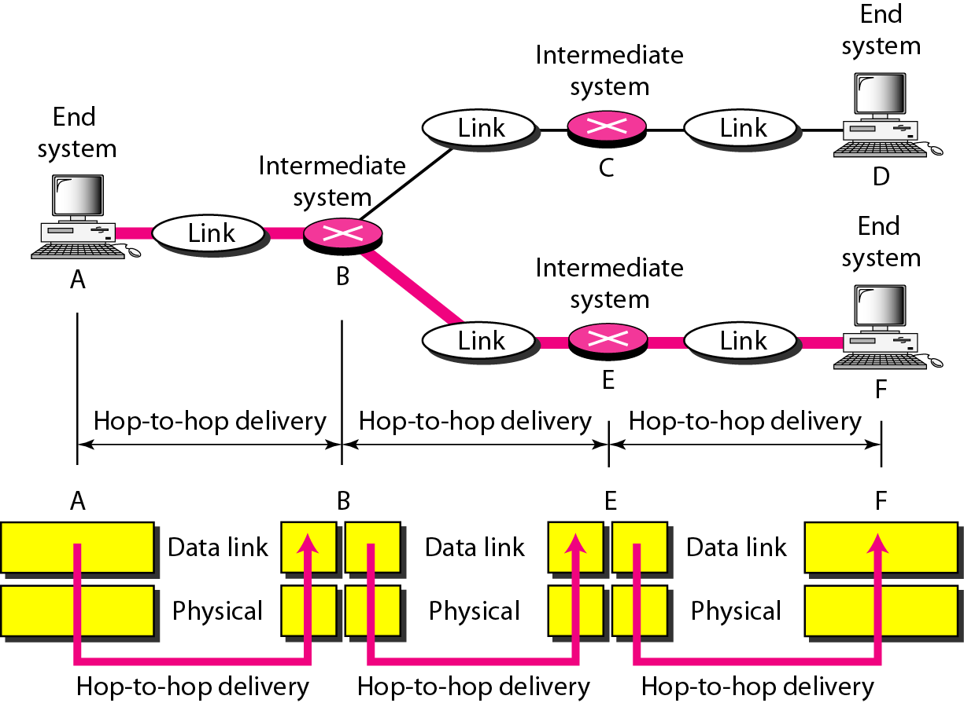
Hop-to-hop delivery
Source: Data Communications and Networking – Behrouz A. Forouzan

Slide 26
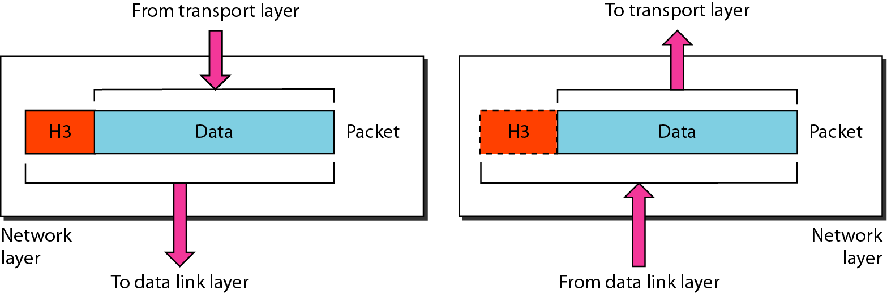
Network layer
The network layer is responsible for the delivery of individual packets from
the source host to the destination host.
Source: Data Communications and Networking – Behrouz A. Forouzan

Slide 27
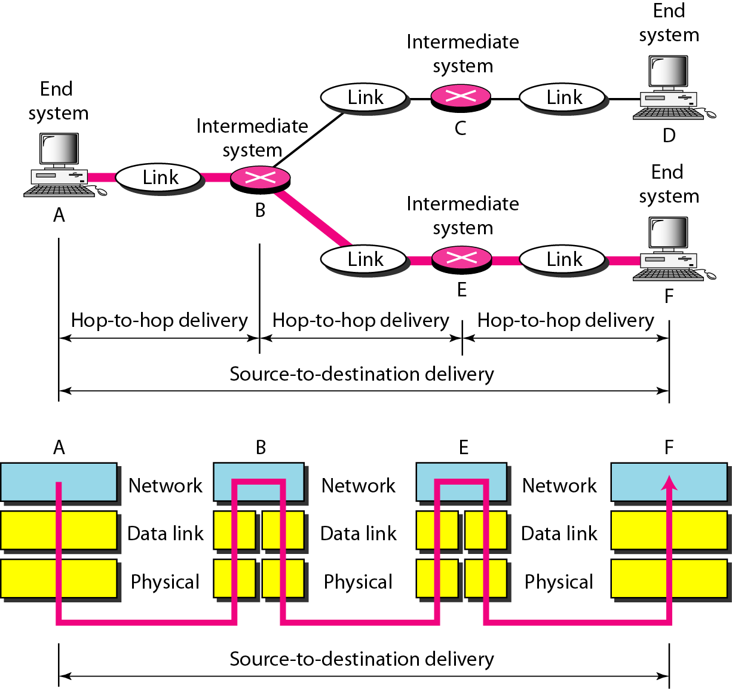
Source to destination delivery
Source: Data Communications and Networking – Behrouz A. Forouzan

Slide 28
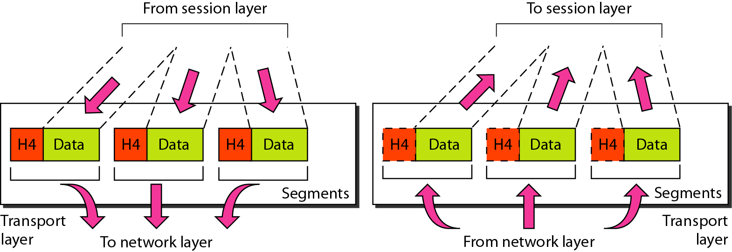
Transport layer
The transport layer is responsible for the delivery of a message from one process to another.
Source: Data Communications and Networking – Behrouz A. Forouzan

Slide 29
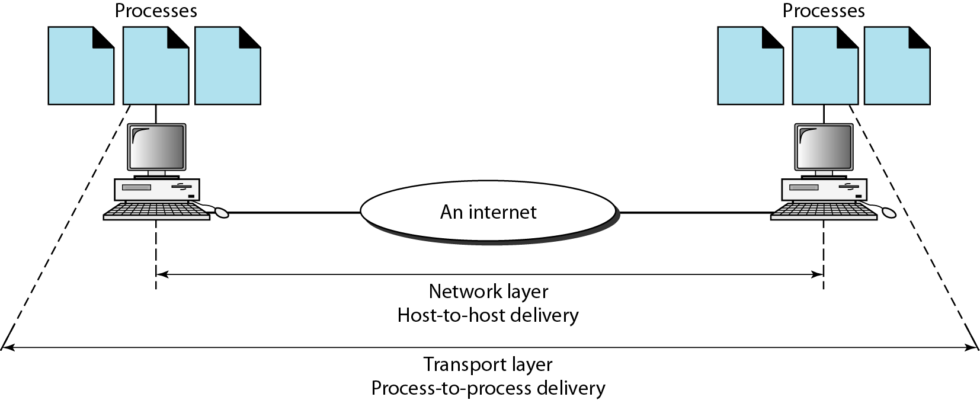
Reliable process-to-process delivery of a message
Source: Data Communications and Networking – Behrouz A. Forouzan

Slide 30
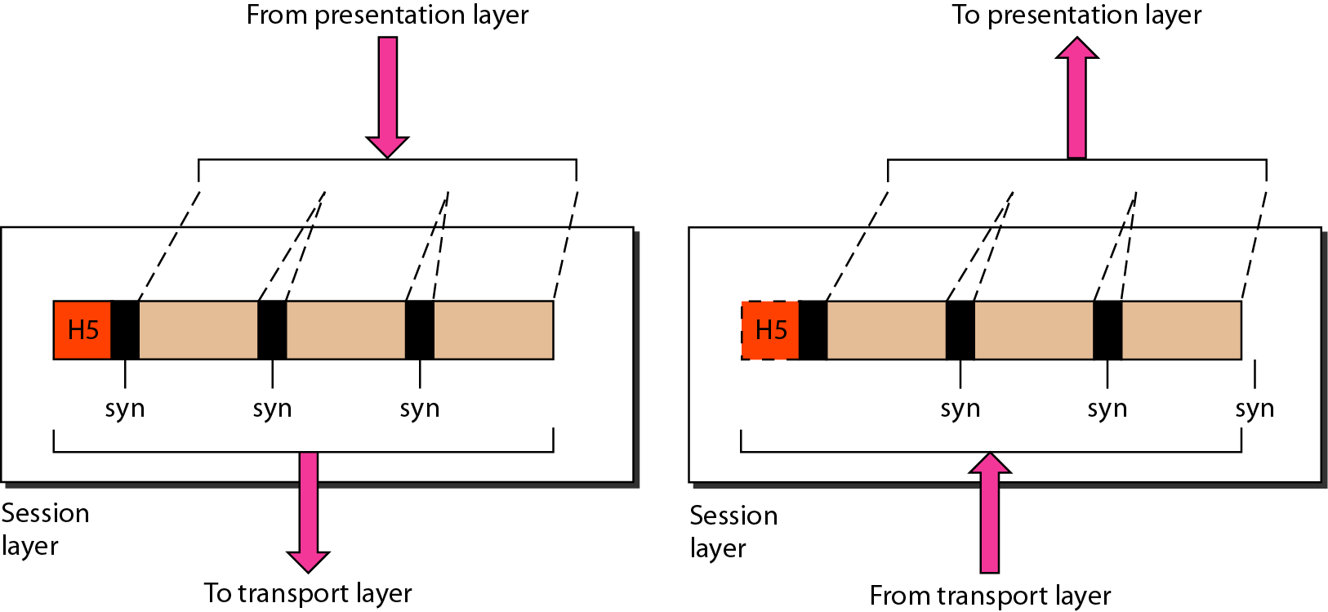
Session layer
The session layer is responsible for dialog control and synchronization.
Source: Data Communications and Networking – Behrouz A. Forouzan

Slide 31
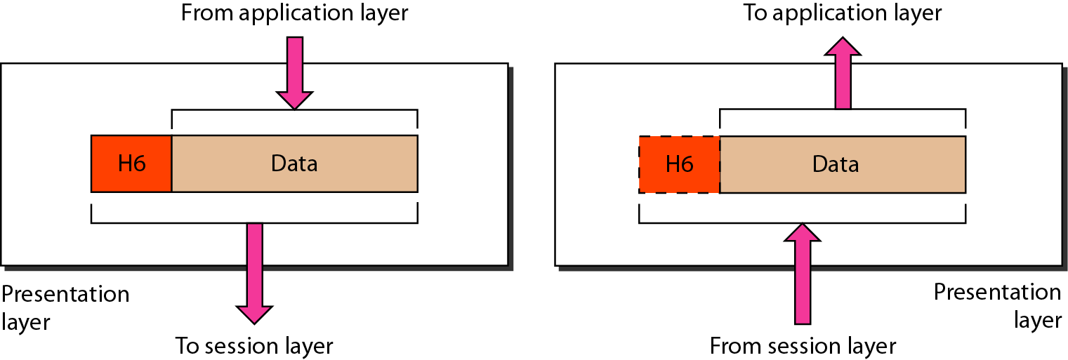
Presentation layer
The presentation layer is responsible for translation, compression, and encryption.
Source: Data Communications and Networking – Behrouz A. Forouzan

Slide 32
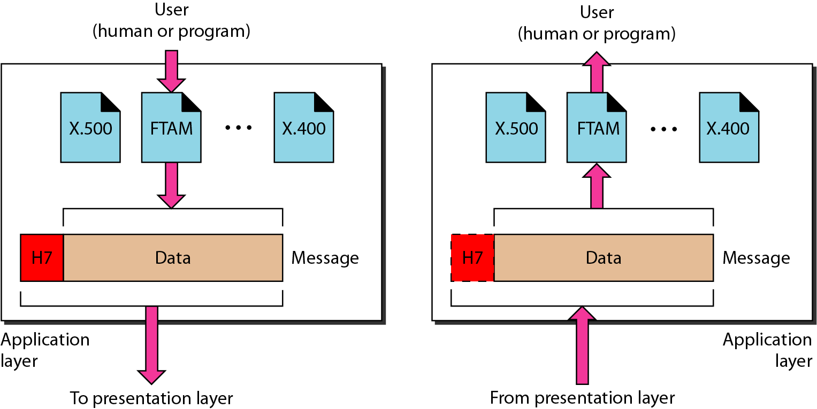
Application layer
The application layer is responsible for providing services to the user.
Source: Data Communications and Networking – Behrouz A. Forouzan

Slide 33
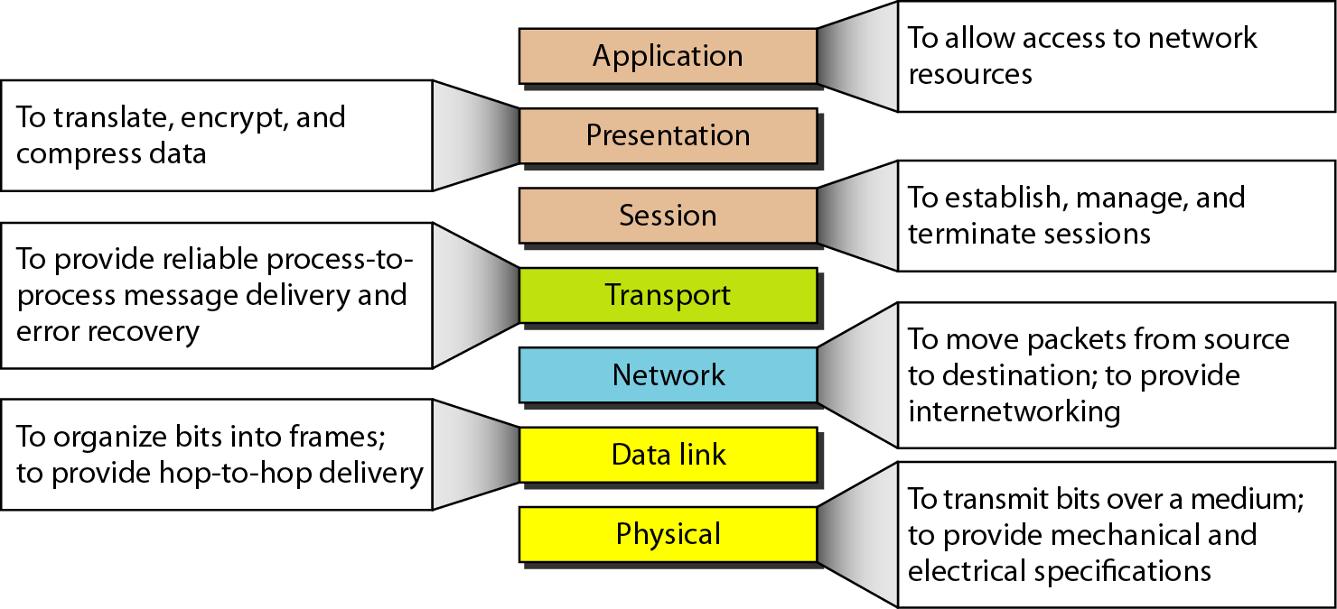
Summary of layers
Source: Data Communications and Networking – Behrouz A. Forouzan

Slide 34
TCP/IP PROTOCOL
DATA COMMUNICATION AND NETWORKING

Slide 35
TCP/IP PROTOCOL SUITE
The TCP/IP is compared to OSI, we can say that the TCP/IP protocol suite is made of five layers: physical, data link, network, transport, and application.
Topics discussed in this section:
Physical Layer
Data Link Layer
Network Layer
Transport Layer
Application Layer

Slide 36
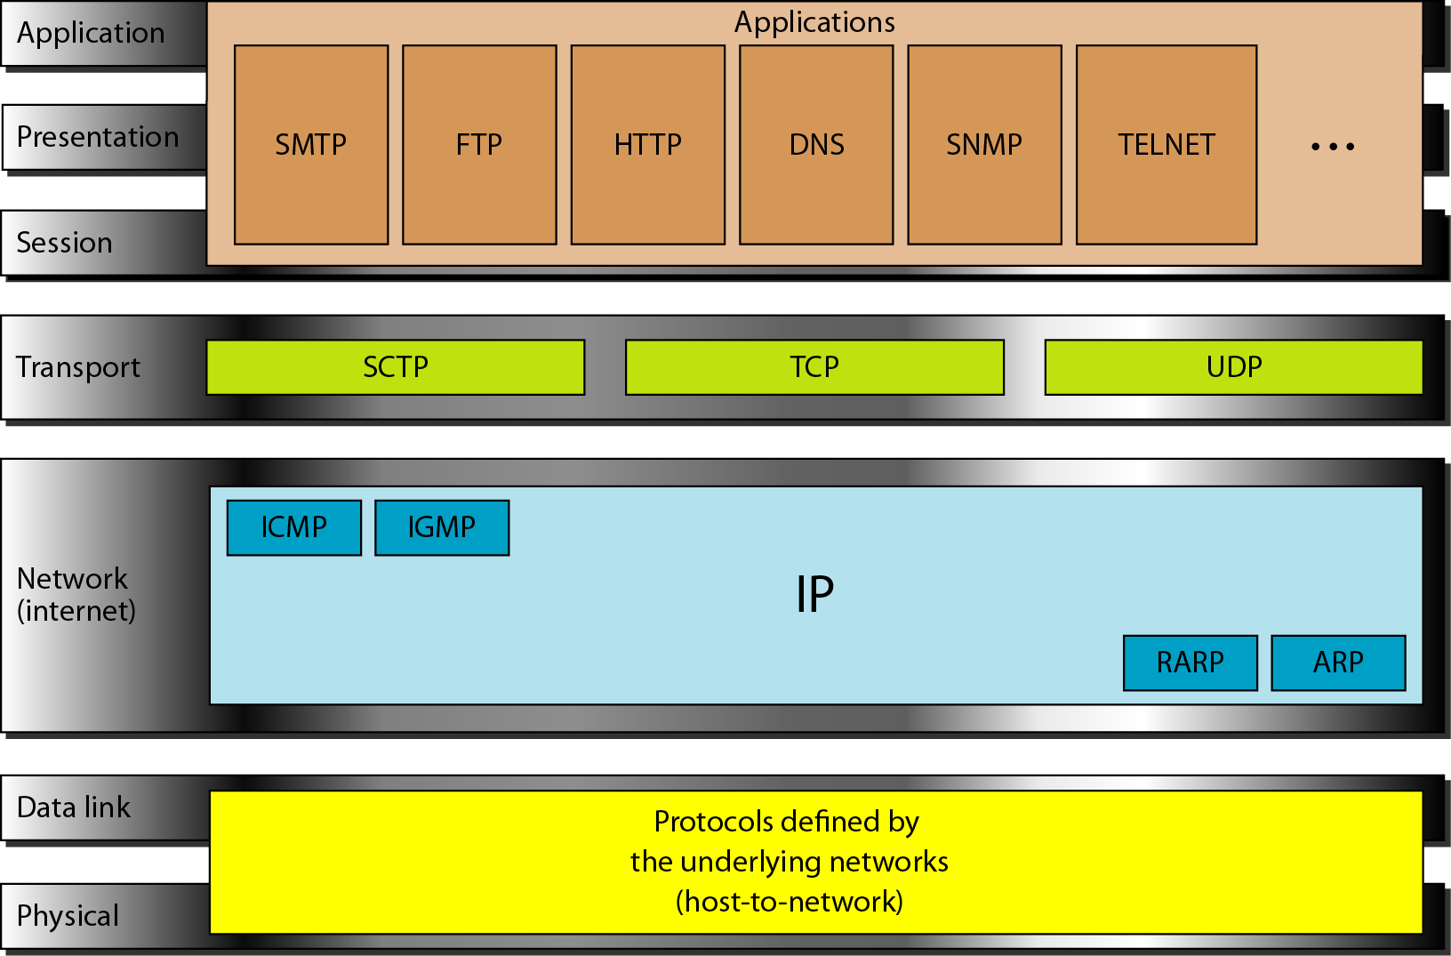
TCP/IP and OSI model
Source: Data Communications and Networking – Behrouz A. Forouzan

Slide 37
Addressing
Four levels of addresses are used in an internet employing the TCP/IP protocols
Physical Addresses
Addresses
Logical Addresses
Port Addresses
Specific Addresses

Slide 38
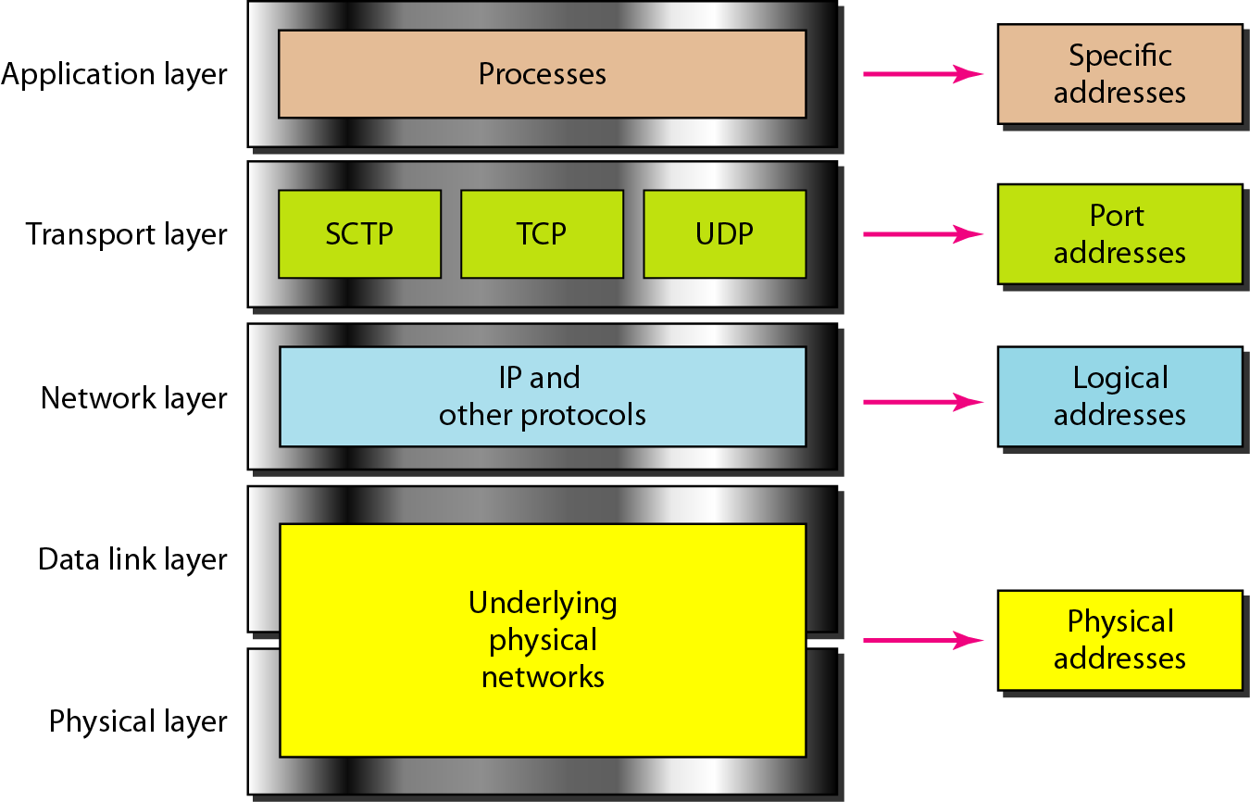
Relationship of layers and address TCP/IP
Source: Data Communications and Networking – Behrouz A. Forouzan

Slide 39
MAC address or Physical address
Most local-area networks use a 48-bit (6-byte) physical address written as 12 hexadecimal digits; every byte (2 hexadecimal digits) is separated by a colon, as shown below:
07:01:02:01:2C:4B
A 6-byte (12 hexadecimal digits) physical address
Source: Data Communications and Networking – Behrouz A. Forouzan

Slide 40
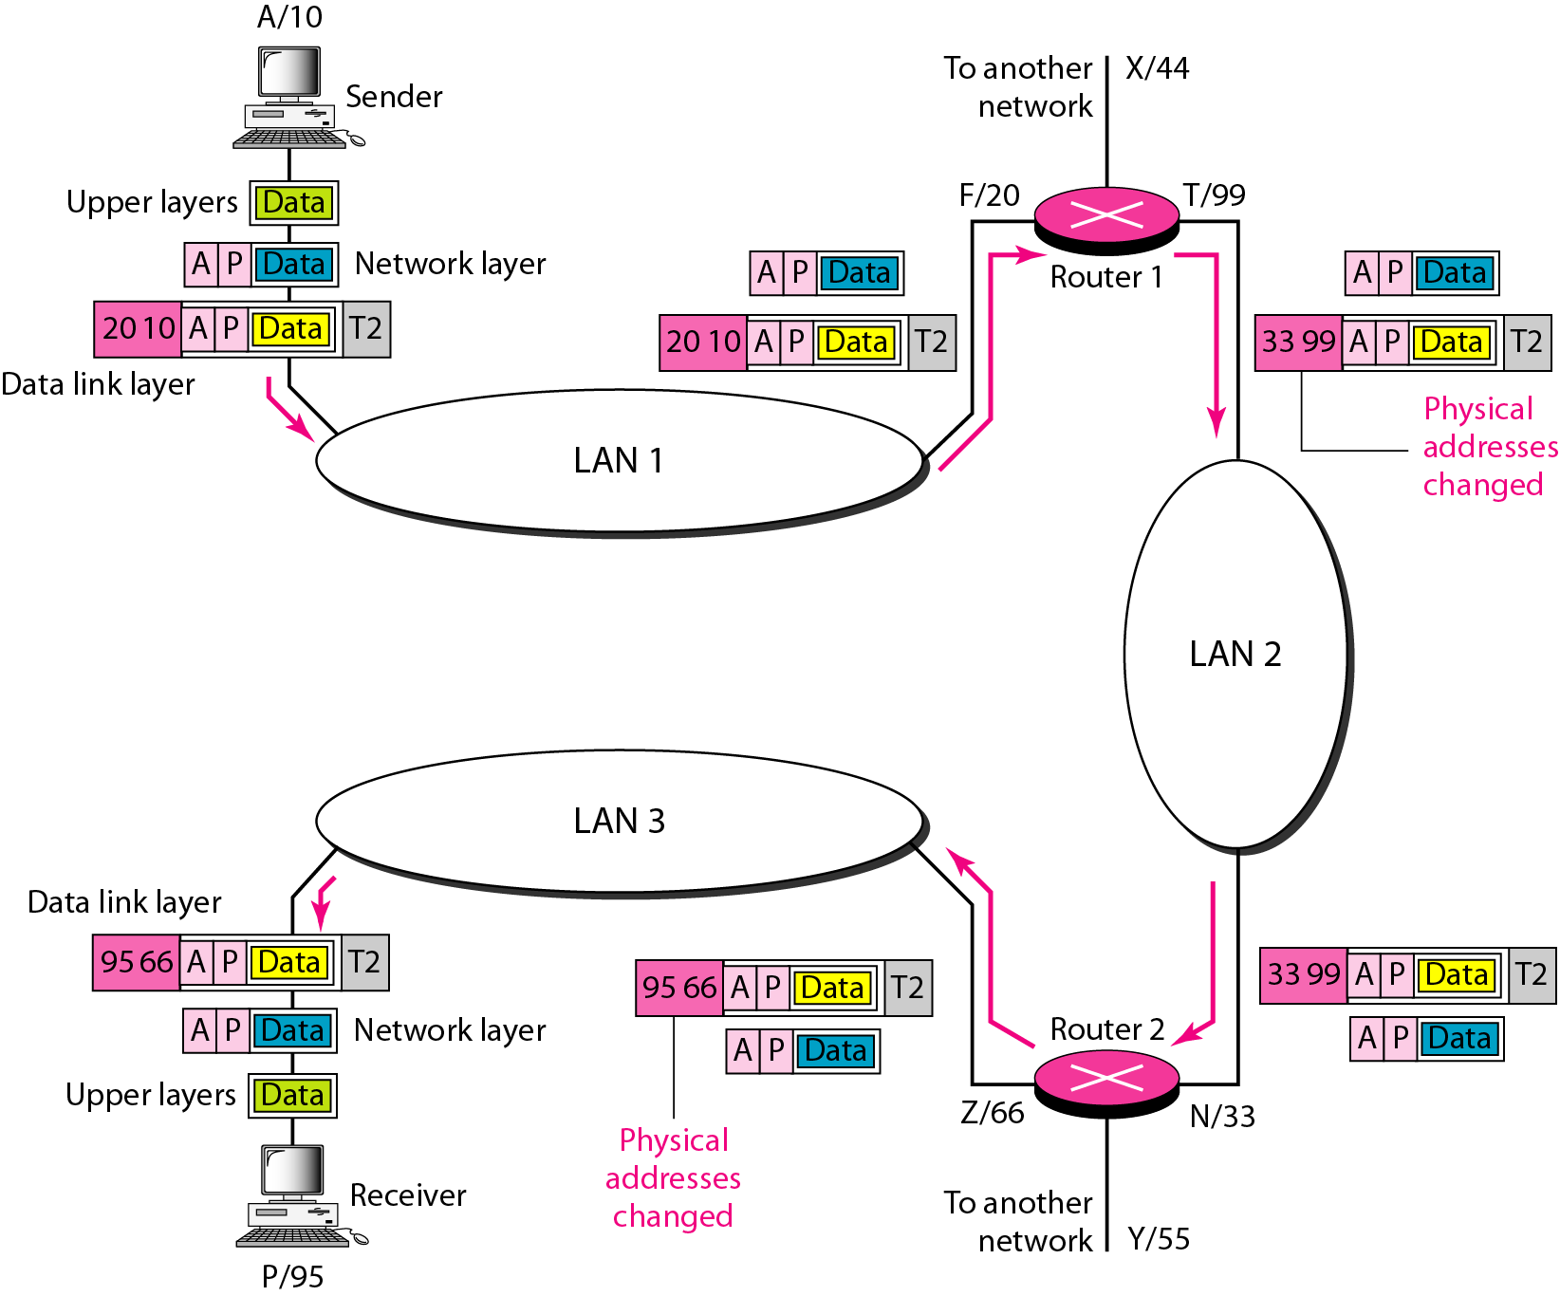
IP Address
The physical addresses will change from hop to hop,
but the logical addresses usually remain the same.
A logical address is a 32-bit(IPv4) or 128-bit(IPv6).
Examples
IPv4: 192.168.2.33 IPv6: 2dbe:ab67:237f:50cd:83fd:ab34:92bd:66ca
Source: Data Communications and Networking – Behrouz A. Forouzan

Slide 41
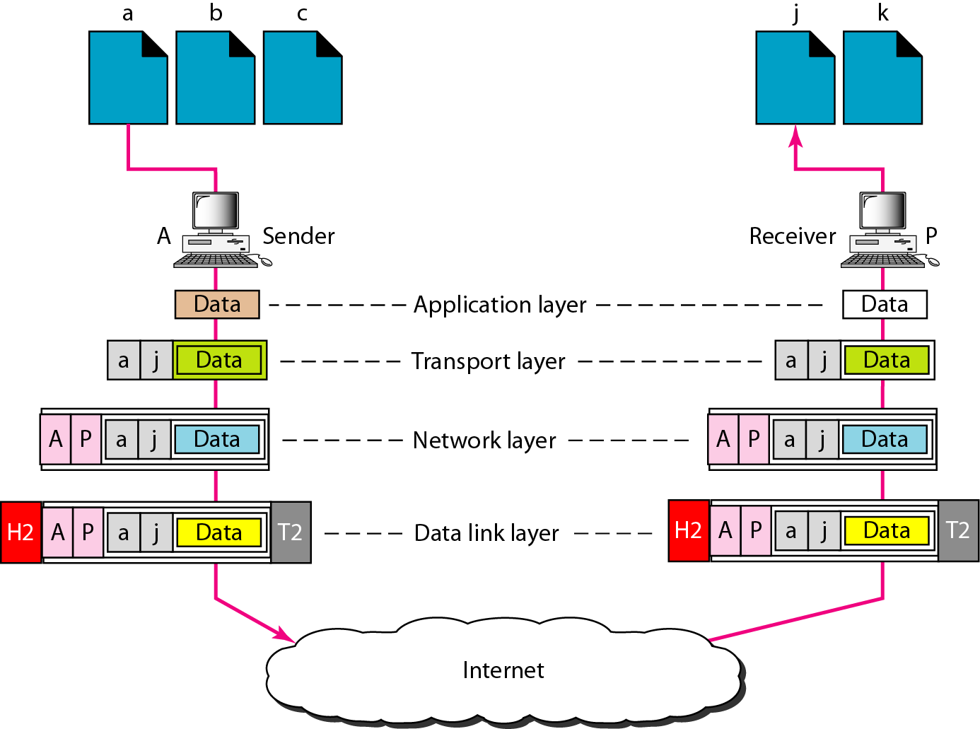
Port address
A port address is a 16-bit address represented by one decimal number. Ex.753
A 16-bit port address represented as single number.
Source: Data Communications and Networking – Behrouz A. Forouzan

